Slide 1





Developing Today’s Leaders for Today and Tomorrow’s Needs
The Lorain County Junior Fair Board
Notes:
Jill

Slide 2

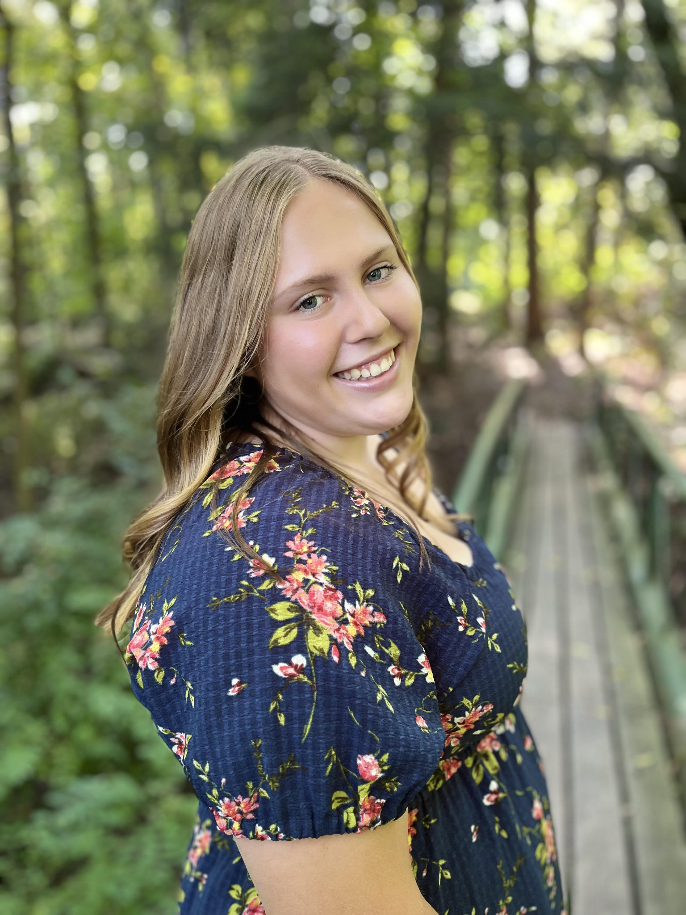
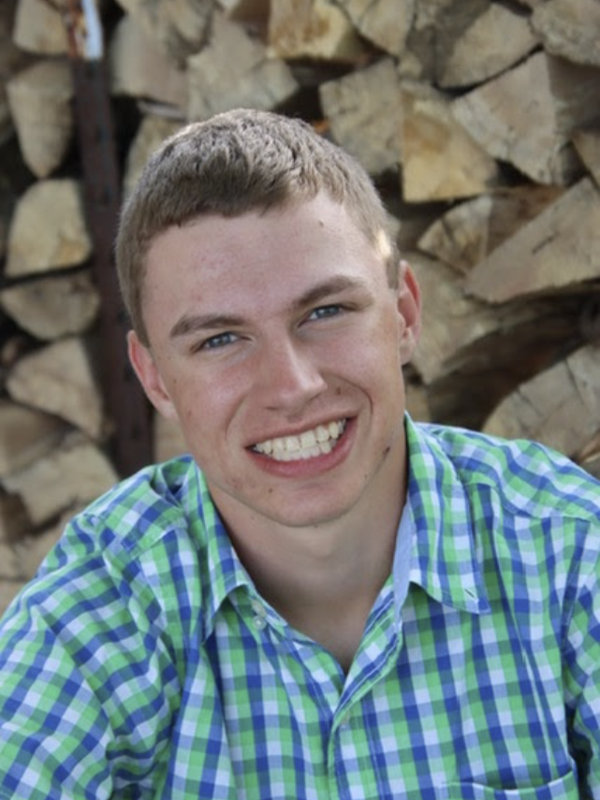
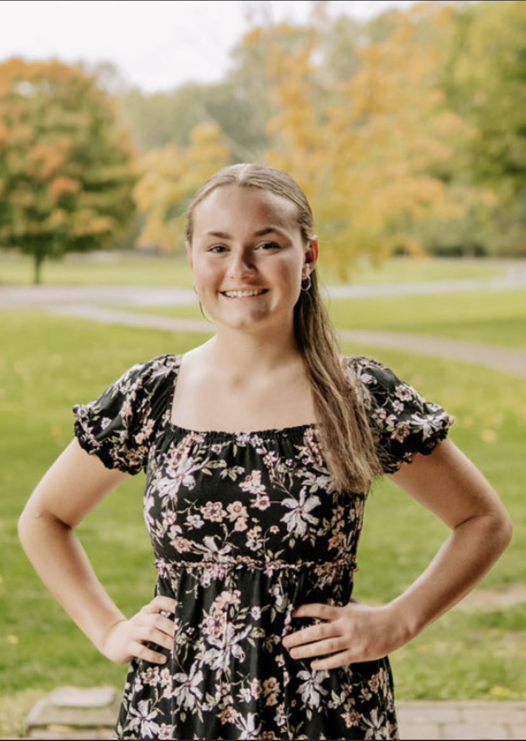
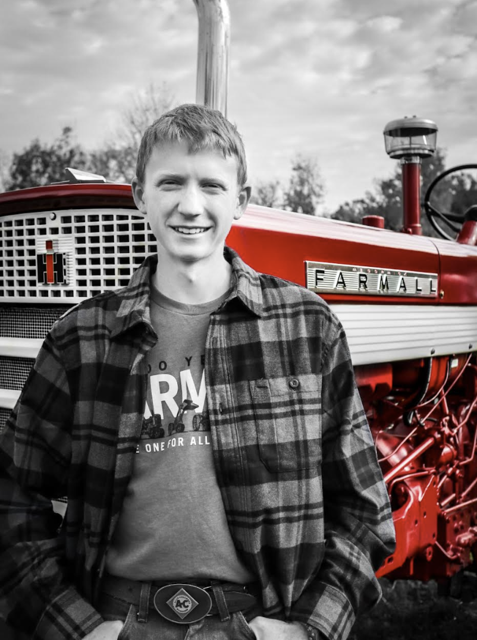
Meet the Team
Jillian Stannard
President
Andrew Krupka
Vice President
Kyleigh Klingshirn
Secretary
Scott Hook
Treasurer
Notes:
Everyone introduces themselves, their positions, and how many years they’ve been involved

Slide 3
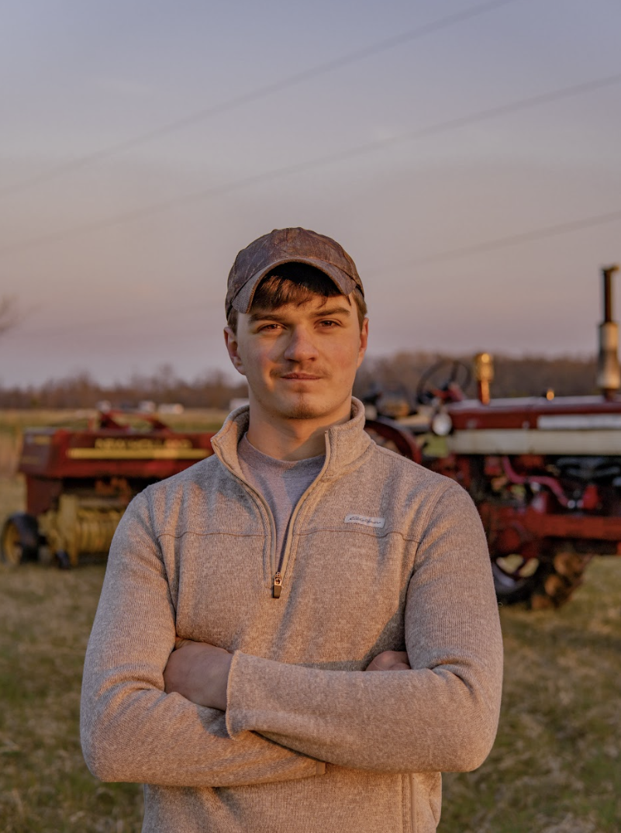
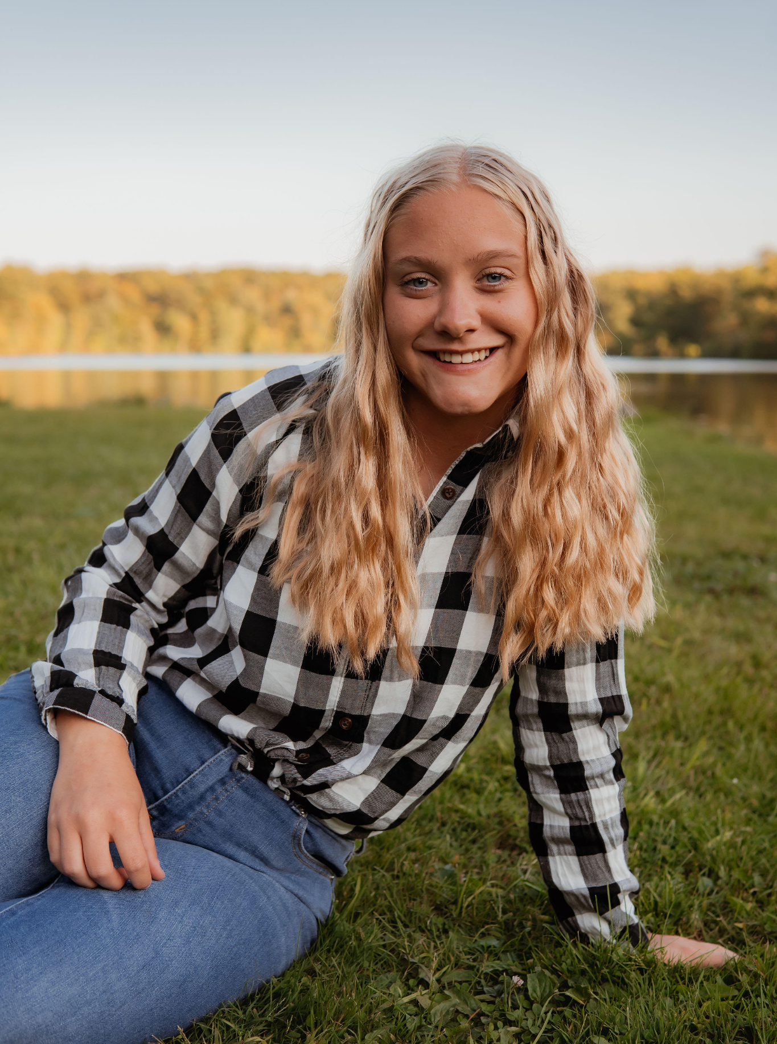
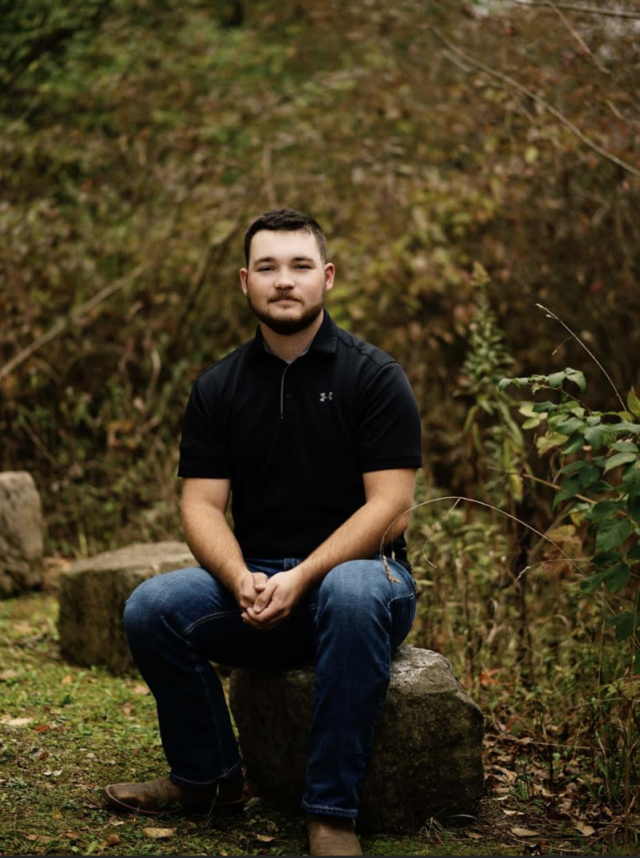
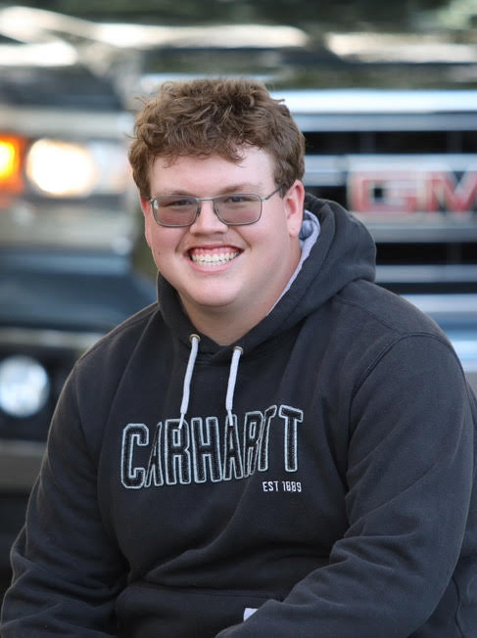
Meet the Team
Holden Harker
Executive Team
Amy Gerber
Executive Team
Nate Sword
Executive Team
Nolan Norman
Executive Team
Notes:
Everyone introduces themselves, their positions, and how many years they’ve been involved

Slide 4

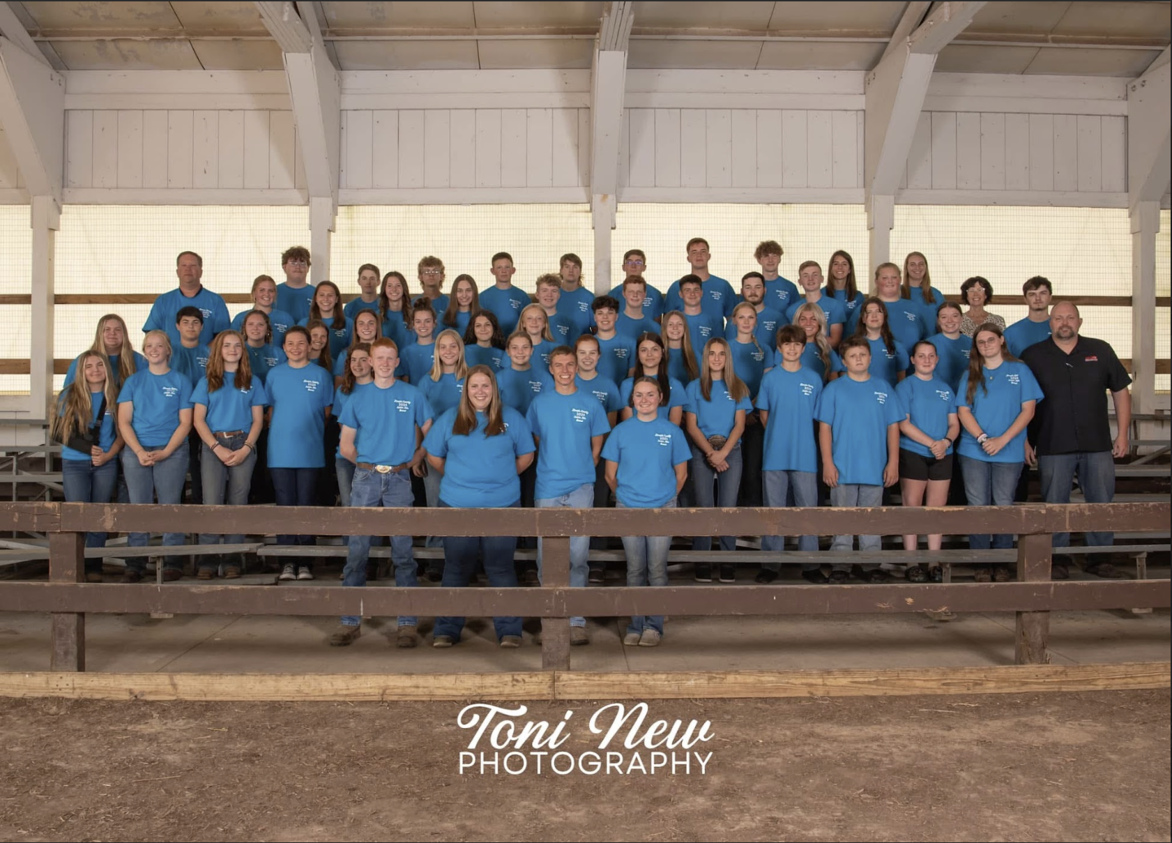
Our Board
We are entirely youth-led with limited adult decision-making
2nd largest county fair in the state!
43 Members
23 Assistants
11 Adult Consultants
4 Advisors
1 Jr. Fair Coordinator
…and countless supporters, donors, partners, and advocates from throughout the county
Notes:
Jill

Slide 5
Seperation of Junior Fair Board from 4-H/FFA
Junior Fair Board runs under the direction of the Lorain County Agricultural Society (Senior Fair Board), not our 4-H extension or FFA/FCCLA advisors
Jr. Fair Coordinator who is hired by SFB
Four JFB advisors that are selected by SFB
Oversee operations and decisions of the Junior Fair Board
Notes:
Holden

Slide 6
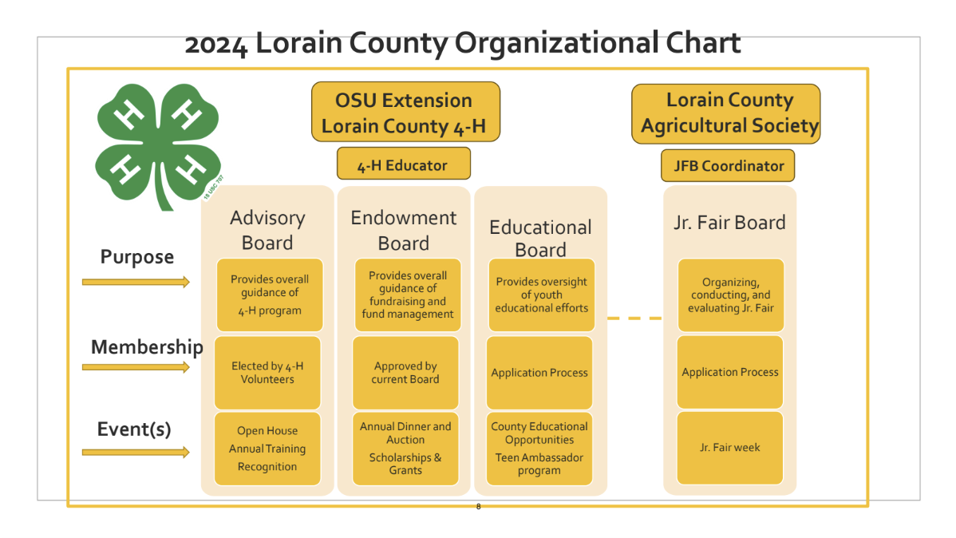
Diagram of Seperation
Notes:
Holden

Slide 7
What Makes a Member
Members are 15-18 years old (as of January 1st of the year of service)
Required to attend meetings, work sessions, and other activities
Serve as department members or even chairs/co-chairs
Members with two unexcused absences are subject to removal from the board; members with three excused absences are subject to meet with the executive board and discuss further actions
Attendance is kept track of by the Secretary
Warning letters are sent to members when this rule is breached
Notes:
Andrew

Slide 8
What Makes an Assistant
Assistants are 13 years and older
Reduced attendance requirements, but are encouraged to come to as much as possible to assist in directing the work of the board
Gain experience from the older members and are being trained for the future
Serve as department assistants
Do not have voting rights
Notes:
Andrew

Slide 9
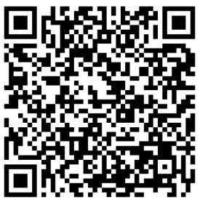
Selection Process of Members
Transitioned to a Google Form application this year
Applications are due on November 30th
Consist of general information as well short answer responses
Application questions surround involvement and past leadership experience
Designed to ensure that our applicants will be contributing members of the board
Selection committee meets in December discusses the applications and decides whether to accept each individual on board
Consists of a SFB members, Jr. Fair Coordinator, 4 JFB advisors, county FFA/FCCLA advisors, and past/newly-elected president and vice president
Tend to have 30-50 members on board (varies per year)
QR Code Link to
Member/Assistant Application
Notes:
Amy

Slide 10
Selection Process of Assistants
Uses the same Google Form application that members use
Applications due on February 1st
Assistants are selected at the February meeting
Officers, executive committee, advisors, and Jr. Fair Coordinator meet to decide
QR Code Link to
Member/Assistant Application
Notes:
Amy

Slide 11
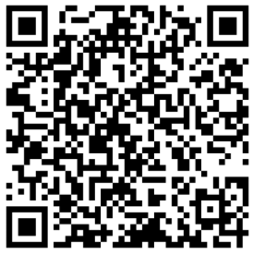
Selection of Officers and Executive Members
Vote on officer/executive board during our banquet at the end of the year
President, Vice President, Secretary, Treasurer, and 4 Executive Members
Submit an application prior to the banquet
Application is used to formalize the nomination process and ensure that all applicants are qualified
Must be nominated when voting opens
Officers cannot hold the same office for more than one year, no limit on executive members
QR Code Link to Officer Application
Notes:
Amy

Slide 12
A and B Department Structure
Every member is on an A & B department
Excluding the President (oversees and a part of all the departments) and Treasurer (on either an A or B department; uses the other time to complete the treasurer’s report)
The board members are broken into A and B departments to diversify talents and spread the board out between all departments.
These departments correspond to the different divisions of entries of the junior fair
Members who are on a specific department are not limited to helping only that department
Notes:
Scotty

Slide 13
Departments
A Departments:
Swine
Horse
Fowl
Dairy
Goat
B Departments:
Sheep
Ag/Home Ec
Beef
Special Events
Rabbit/Small Animal
Dog
Notes:
Scotty

Slide 14
A and B Department Structure
Departments are in charge of completing paperwork, organizing/planning shows, weigh-ins, and other department-related activities, and much more
Consists of a chair, co-chair, a JFB advisor, adult consultant(s), members, and assistants
Meet for roughly 15-20 minutes each during each meeting
Departments schedule additional time outside of meetings as needed
Red Pen Changes
Completed by departments to make changes to our Jr. Fair Premium Book
Review rules that may need to be updated, added, or deleted based on suggestions throughout the year
Voted on by the board during the first few meetings of the year
Notes:
Scotty

Slide 15
Selection of Chairs, Co-Chairs, & Department Members
The officers, executive committee, JFB advisors, and Jr. Fair Coordinator meet in December to plan out the year as well as decide department chairs/co-chairs and members
Members indicate if they would like to be a chair/co-chair on their application
Chairs/co-chairs oversee much of what is happening in the department and lead everyone else in completing what needs to be done
The committee takes what is on their application into consideration as well as their other obligations and their experience on board
Members and assistants rank the departments they would like to be on and are placed accordingly
Notes:
Nate

Slide 16
Selection of Adult Consultants
Community volunteers submit applications to become adult consultants of each department
Applications are due on January 1st
Department chairs/co-chairs review these applications during the January meeting
Adult consultants may serve a maximum of three years on a specific department
Provide industry and show knowledge
Assist in supporting JFB decisions
Have no voting privileges
Choose 1 adult consultant per department
A department with multiple industry standards may choose to have a 2nd consultant (ex. saddle horse and small equine/boer goat and dairy goat)
Notes:
Nate

Slide 17
C Departments
Groups created for improved board communication
Each of the officers and executive members are chairs of a C Department
Entirety of the board is divided into these departments
Used for communication, bonding activities, and competitions
Each C Department has a group chat for reminders, questions, and much more
Other forms of communication
Email reminders are sent out by the President to remind the board of meetings and other activities
Agendas and minutes are sent out prior to meetings
A shared Google Calendar is also provided for members to refer back to dates
Notes:
Nate

Slide 18
Schedule of Events (Meetings)
Monthly meetings (January-July)
Fourth Thursday of each month
January consists of officers, executive members, and department chairs/co-chairs
February consists of all of the members
March consists of the entire board (members and assistants)
Following the July meeting, they become weekly until fair week
Our fair week is always the third full week in August
Following fair week, we have our input meeting on the fourth Thursday of September
Community members and exhibitors are invited to come and give their input to improve the fair the next year
Each department has a table; half hour time slots for A and B departments
No decisions are made at this meeting, but ideas are documented for discussion at a regular board meeting
Our banquet typically falls on a weekend during the first few weeks of November
Celebration of our board and the fair
Officer/Executive Member and Jr. Fair theme voting is held
Notes:
Nolan

Slide 19
Schedule of Events (Work Sessions/Other Activities)
Work sessions take place during the first few months of the spring to get pre-fair work done (leaf clean-up, pressure washing, painting, trash pick-up, etc.)
Once August hits, they happen daily from 2-8pm
Complete projects throughout the barns such as pen cards, barn layouts, stall/pen set up, general clean-up, etc.
Advisors/officers walk through the fairgrounds and create a list of tasks that need to be completed
The list is then put up on the big whiteboard in the office and the officers/executive members help guide the rest of the board in getting everything done
Clean-up takes place during the week after fair and the following weekends
Other activities happen all throughout the year including market weigh-ins, taggings/tattooings, and pre-fair shows
Members/assistants spend roughly 297 hours a year completing Jr. Fair activities
Notes:
Nolan

Slide 20
Fundraising
Sponsorships (Entire Board)
We utilize sponsorships to raise money for projects and other expenses such as gate/pen repairs, ventilation and fans, sawdust for show rings, signage/banners, etc.
Different levels of sponsorship:
Top Sponsor, Platinum Day, Premier, Gold Pen, Silver, and Friends of the Junior Fair
Members/assistants are tasked with reaching out to the community to raise these funds
Competition to collect the most between individuals and C Departments
Set a board goal each year and have a pool party if we surpass it
Sponsors are advertised on banners, slideshows, and announced during shows
Notes:
Kyleigh

Slide 21
Fundraising
Junior Fair T-Shirt Sales (handled by Special Events Department)
Sold at the JFB office during fair week and an online sale (including pre-order option)
T-Shirts are designed by youth exhibitors and voted on by the board
Fight the Hunger, Stock the Trailer (handled by Stock the Trailer Committee)
Third year in a row state winner with 32,580 pounds collected this year
Offered food to local food banks as well as hurricane relief
Notes:
Kyleigh

Slide 22
Trainings and Orientations
We strive to get all of our members/assistants involved in all aspects of running our Jr. Fair
In order to ensure everything is done to the best of our capabilities and that the younger/newer members are learning how to do things, we hold training sessions and orientations throughout the year:
Chair/Co-Chair Orientation (January)
New Member Orientation (February)
Assistant Orientation (March)
Get to Know You Activity with SFB (March)
Parliamentary Procedure Training (March)
De-Escalation Training (April)
Notes:
Kyleigh

Slide 23
Trainings and Orientations
Power Tool Training (May)
C Department Scavenger Hunt (May)
Show Management Training (June)
Pre-Show Work, Day of Show, and Conclusion of Show
Microphone Training (July)
Office Shift Training (August)
Notes:
Kyleigh

Slide 24
Developing Today’s Leaders for Today and Tomorrow’s Needs
Remember…It is always important to be pulling in all of the members to help out instead of just doing all of the work yourself
This helps lighten the workload and stress on one person and allows others to become involved
It is important to see the light in others and push them to be strong JFB members and leaders for the community
We are proud to be the leaders of our Jr. Fair!!
Notes:
Kyleigh

Slide 25
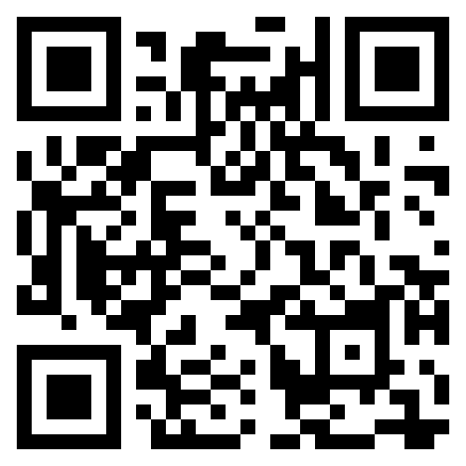
Questions???
Member/Assistant
Application
Officer
Application
Follow us on Facebook!
Notes:
Kyleigh

Slide 26
Activity Rules
Once broken into groups, arrange into a circle.
Go around the circle and introduce yourselves (name and county).
One person will start with a tennis ball. They will call someone’s name and throw the ball to them.
That person will then call someone else’s name and throw the ball to them.
Make sure everyone in the group has had the ball thrown to them.
The last person will throw the ball back to whoever started with it.
The cycle will then start again and you will follow the same pattern, throwing the ball to the same person you did the first time.
As this continues, additional tennis balls will be added in.
Notes:
Kyleigh explains the game; everyone will walk around and help everyone get into it

